Slide 1






Data Analysis & Insights Report
Prepared by Pankaj Kumar SRMCEM Lucknow
[Insert today’s date]

Slide 2
Agenda
1
Introduction & Objectives
2
Data Cleaning Procedures
3
Establishing SQL Connections & Queries
4
In-depth Data Analysis
5
Power BI Dashboard Development
6
Jupyter Notebook Explorations
7
VS Code Scripting & Version Control
8
Key Visualisations & Interpretations
9
Actionable Insights & Recommendations
10
Conclusion & Next Steps

Slide 3
Introduction: Objectives & Datasets
Core Objectives
Datasets Utilised
1
Analyze & Clean
Sales_Data.csv: Comprehensive sales records, including product, region, and revenue.
Thoroughly process complex datasets to ensure data quality.
Customer_Demographics.xlsx: Detailed customer information with age, gender, and location.
2
Extract Insights
Marketing_Campaigns.csv: Data on various marketing initiatives and their performance.
Uncover hidden patterns and actionable intelligence from data.
Website_Traffic.csv: User engagement metrics from the company website.
3
Financial_Records.xlsx: Transactional data and financial summaries.
Visualize Patterns
Create compelling visualisations for clear data representation.
Employee_Performance.csv: HR data detailing employee metrics and departmental information.
4
Provide Recommendations
Deliver data-driven strategies for informed decision-making.

Slide 4



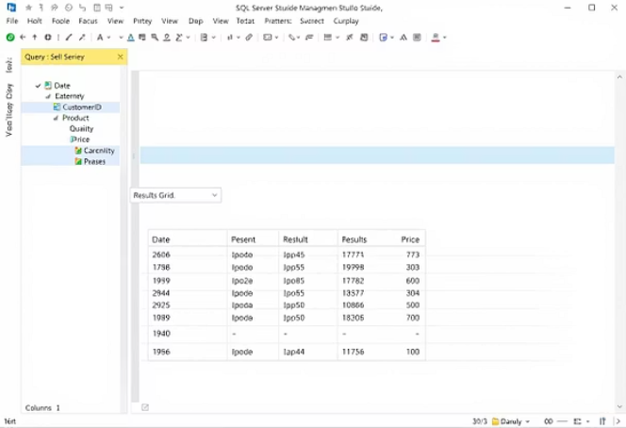
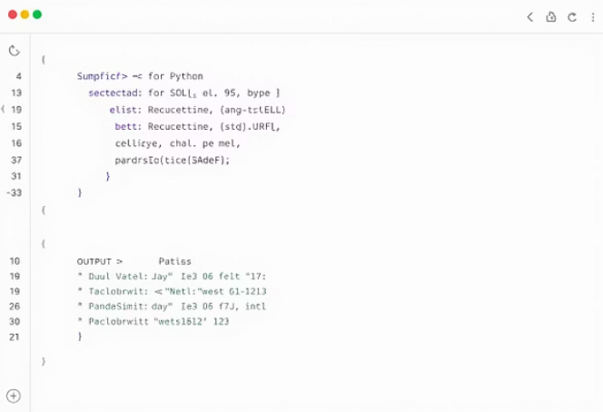
Establishing SQL Connections & Queries
Seamless Database Integration
Key SQL Operations Performed
SQL Server Management Studio (SSMS)
1
Data Retrieval & Joins
Direct connection to Microsoft SQL Server databases for initial exploration and data import, ensuring data integrity from the source.
Extensive use of SELECT, JOIN, WHERE, GROUP BY, and ORDER BY for complex data extraction and aggregation across multiple tables.
Jupyter Notebook Integration
2
Data Manipulation Language (DML)
Utilised sqlalchemy and pyodbc for robust connections, allowing SQL queries to be executed directly within notebooks and results seamlessly integrated into Pandas DataFrames.
Applied INSERT, UPDATE, and DELETE statements for controlled data modification and maintenance within the databases.
3
Analytical Aggregations
VS Code Connectivity
Executed advanced analytical queries using aggregate functions such as SUM(), AVG(), and COUNT() to derive key business metrics.
Developed and tested SQL scripts efficiently within VS Code, leveraging SQL extensions like the MSSQL plugin for streamlined database interactions.

Slide 5




Introduction: Objectives & Datasets
Key Project Objectives
Data Cleaning
Actionable Insights
Ensured integrity by fixing duplicates, missing values, and inconsistencies.
Identified critical patterns to inform strategic decision-making.
Visualise Patterns
Drive Decisions
Created clear, interactive, and static visualisations for effective communication.
Developed practical, data-backed recommendations for improvements.
Project Scope & Datasets
Project Scope
Core Datasets Utilised
This project combined diverse datasets (CSVs, Excel, SQL) for comprehensive analysis. It employed Python libraries (Pandas, NumPy) and Power BI for exploration, statistical summaries, and advanced visualisations.
Sales Data CSV: Daily transaction records with sales, discounts, and profits.
Customer Info XLSX: Customer demographics and segmentation.
Product Catalog CSV: Details about product categories, SKUs, and pricing.
Regional Performance CSV: Sales performance data segmented by region or store.

Slide 6

Key Insights & Recommendations
The comprehensive analysis revealed critical insights, forming the basis for actionable recommendations.
Category Imbalance Detected
A significant imbalance in certain categorical datasets suggests a need for re-evaluation of data collection strategies or targeted interventions for underrepresented categories.
Correlation & Redundancy
Identified strong correlations between specific numeric features, indicating potential data redundancies. This opens opportunities for feature engineering and dimensionality reduction to optimise models.
Outliers Impacting Averages
Analysis of numeric distributions revealed prominent outliers. These extreme values significantly skewed averages, indicating a need for robust statistical methods or outlier treatment during future modelling.
Seasonal/Cyclical Behaviour
Distinct patterns pointed to seasonal or cyclical trends in the data. Recommendations include developing time-series forecasting models and aligning business operations with these predictable cycles for maximised efficiency.

Slide 7
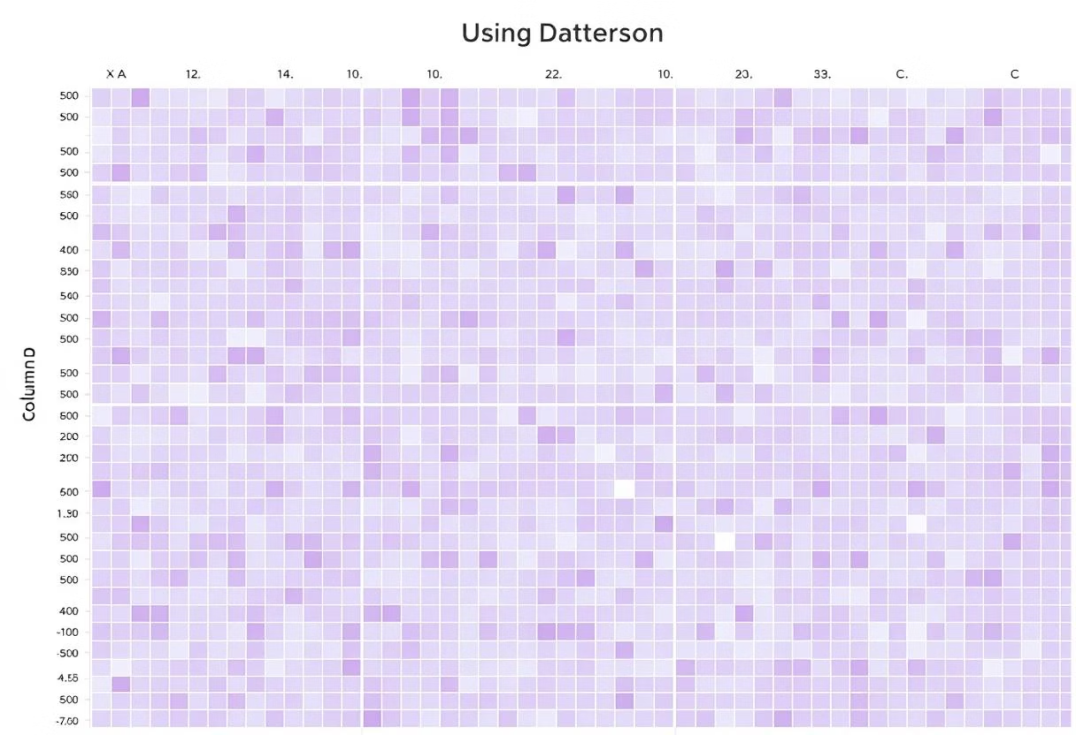
Data Cleaning: Ensuring Data Integrity
Before any analysis, rigorous data cleaning was performed to ensure accuracy and reliability.
Key Cleaning Steps
Missing Values Heatmap
1
Initial Data Inspection
Assessed the original shapes and dimensions of all datasets to understand their structure.
2
Duplicate Removal
Identified and eliminated duplicate entries to prevent skewed analysis and ensure unique records.
3
Missing Value Handling
Strategically filled missing values using appropriate imputation techniques or dropped columns/rows where data sparsity was high.
4
Standardised Naming Conventions
Renamed and standardised column headers across all datasets for consistency and ease of merging/analysis.
The heatmap visually represents the distribution of missing values across the cleaned datasets, highlighting areas that required significant imputation or removal. Darker shades indicate a higher concentration of missing data points.

Slide 8

VS Code Work: Scripting & Version Control
Visual Studio Code served as the primary Integrated Development Environment (IDE) for robust script development and project management.
VS Code Workflow Highlights
VS Code Python Script Example
1
Python Script Development
Wrote efficient and modular Python scripts for end-to-end data processing, from raw data ingestion to final visualisation exports.
2
Integrated Git for Version Control
Utilised VS Code's integrated Git features for seamless version control, allowing for collaborative development, change tracking, and rollback capabilities.
3
Efficient Debugging & Testing
Leveraged VS Code's powerful debugging tools to efficiently identify and resolve issues in scripts, ensuring code reliability and performance.
This image captures a representative view of the Python script within VS Code, demonstrating the structured code, syntax highlighting, and the professional environment used for development and debugging.

Slide 9
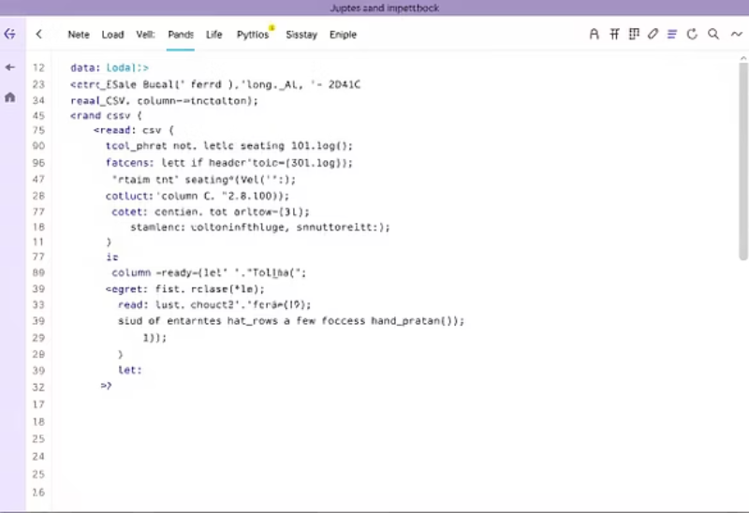
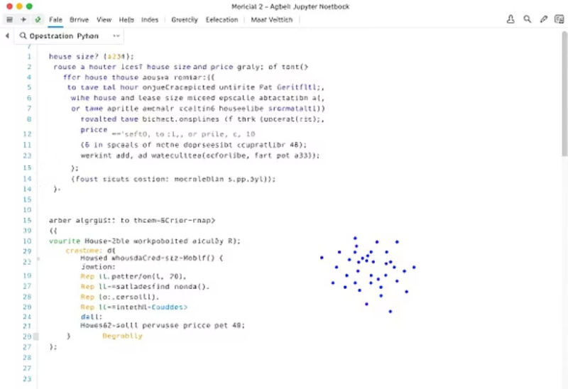
Jupyter Notebook Work: In-depth Exploration
Jupyter Notebook provided an agile environment for iterative data exploration, analysis, and visualisation through Python.
Core Activities in Jupyter Notebook
Jupyter Notebook Snippets
1
Deep Dataset Exploration
Utilised Pandas for extensive data manipulation, aggregation, and querying, uncovering intricate relationships within datasets.
2
EDA Plots with Matplotlib/Seaborn
Generated a wide range of Exploratory Data Analysis (EDA) plots to visualise distributions, correlations, and outliers effectively.
These snippets illustrate typical code cells from the Jupyter Notebook, showcasing data loading, initial descriptive statistics, and a sample visualisation output, demonstrating the interactive nature of the analysis.
3
Step-by-step Documentation
Documented every stage of the data cleaning, analysis, and visualisation process within the notebook, ensuring reproducibility and clarity.

Slide 10

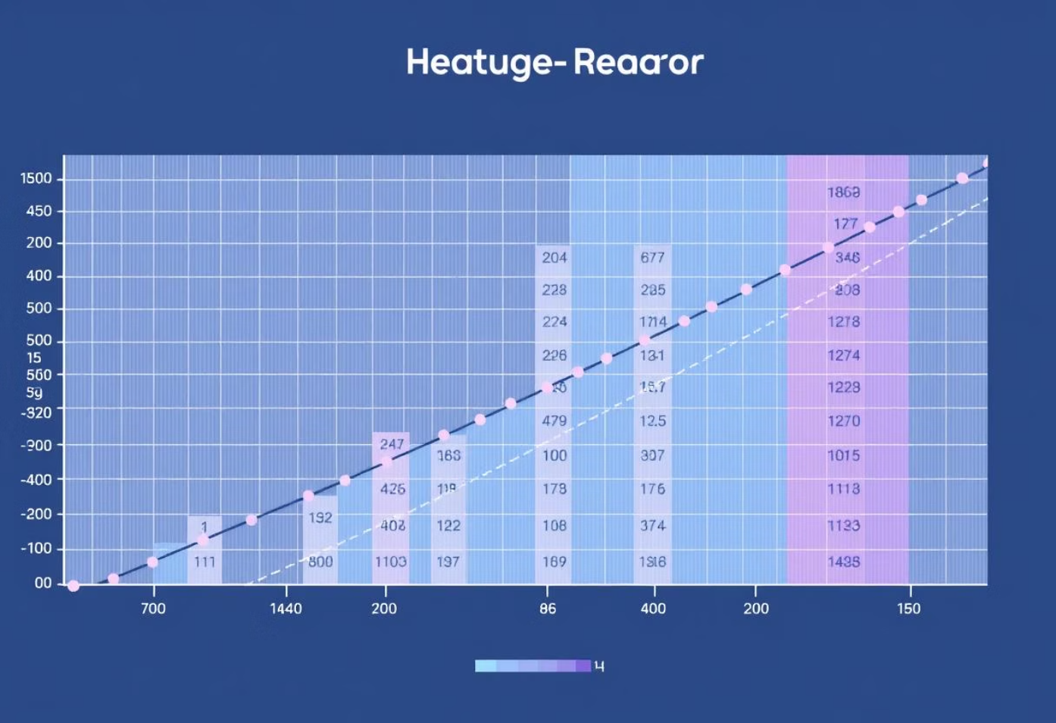



In-depth Data Analysis
Post-cleaning, a comprehensive data analysis was conducted to uncover underlying patterns and statistical properties.
Analytical Approaches
Correlation Heatmap
Summary Statistics
Calculated mean, median, mode, standard deviation, and unique counts for all numeric and categorical features to understand central tendencies and dispersion.
Dataset Information
Examined data types and non-null counts for each column to verify data quality and consistency after cleaning.
Top Category Identification
Identified the most frequent categories within key categorical columns to highlight dominant segments or groups (e.g., top-selling products, most active customer regions).
This heatmap illustrates the pairwise correlation coefficients between different numerical variables. Strong positive correlations are shown in brighter colours, while strong negative correlations appear in darker shades, indicating inverse relationships.
Correlation Analysis
Generated a correlation heatmap to visualise relationships between numeric features, helping to identify potential collinearity and feature importance.

Slide 11
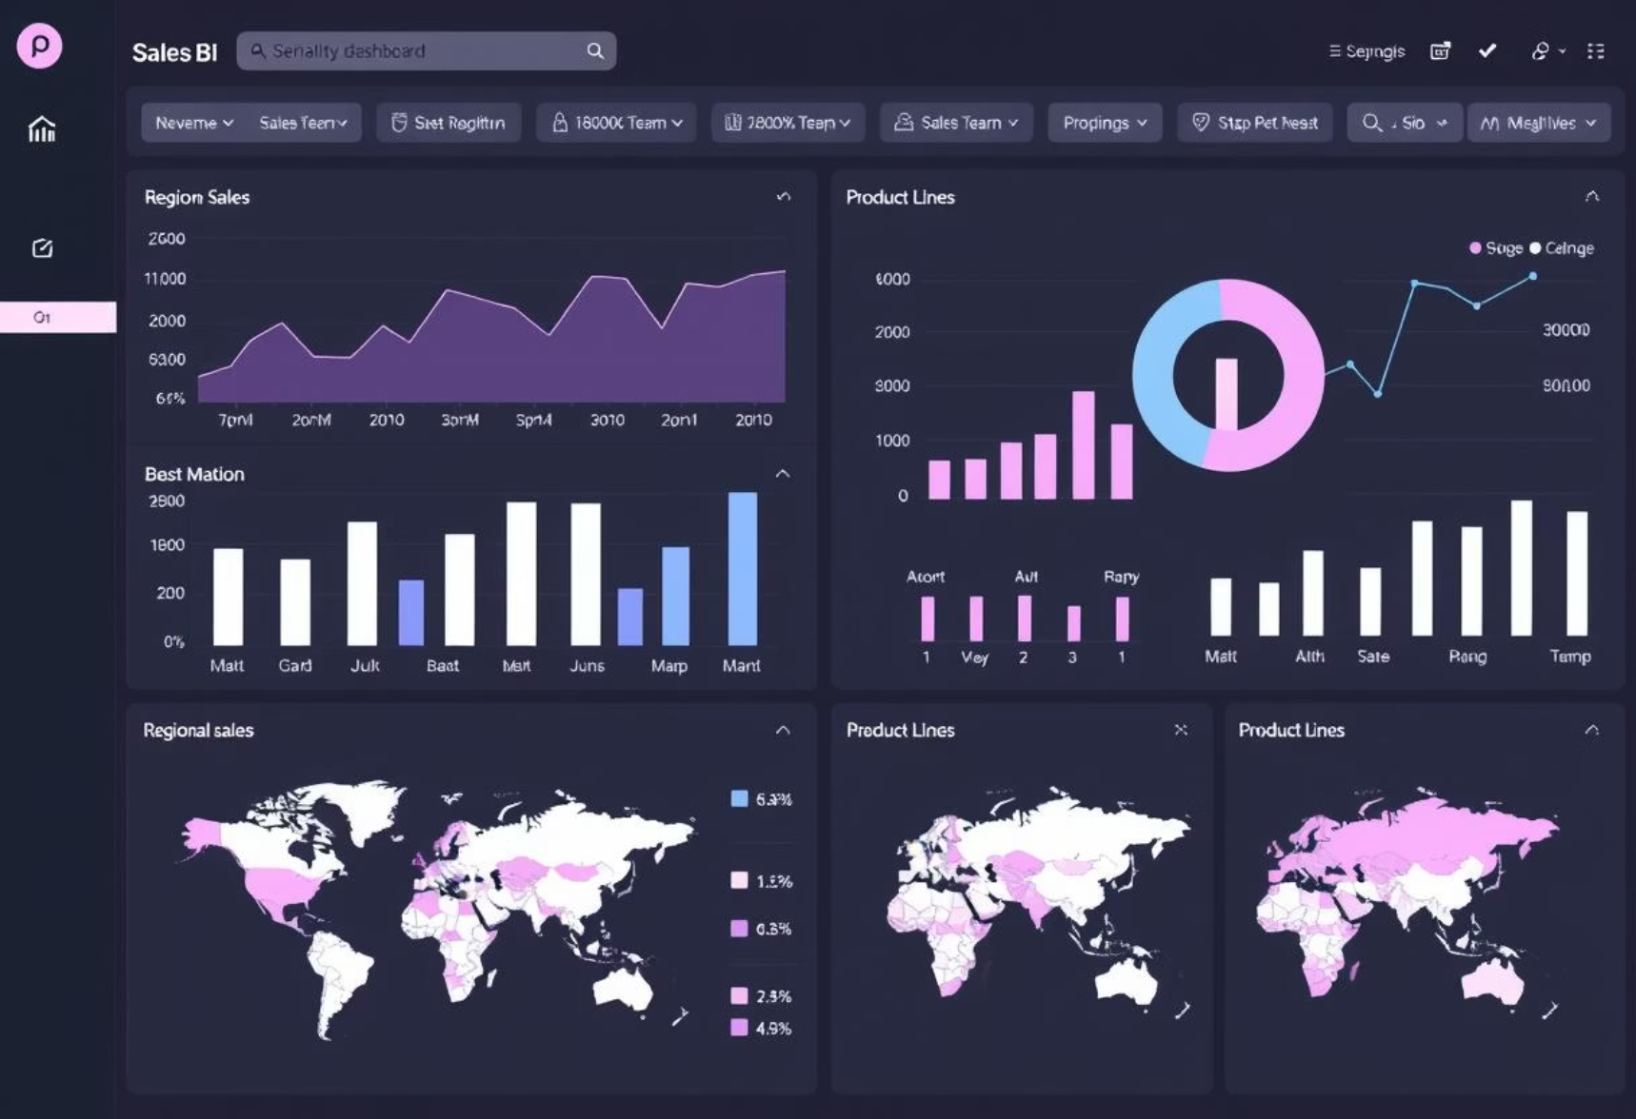
Power BI Work: Interactive Dashboards
Power BI was instrumental in transforming raw data into dynamic, interactive dashboards for easy consumption of insights.
Key Power BI Contributions
Power BI Dashboard Example
1
Interactive Dashboard Creation
Designed and developed comprehensive dashboards, allowing users to interact with data through slicers, filters, and drill-downs.
2
Key Metric & KPI Analysis
Visualised critical business metrics and Key Performance Indicators (KPIs) such as revenue growth, customer acquisition costs, and operational efficiency.
3
Granular Data Filtering
Implemented advanced filtering capabilities to explore specific segments of sales data, regional performance, or customer behavioural patterns in detail.
This screenshot demonstrates a segment of the Power BI dashboard, showcasing a live view of sales performance by region and product category. Interactive filters enable users to drill down into specific data points and periods.

Slide 12
Data Cleaning: Ensuring Data Integrity
Effective data cleaning is foundational, transforming raw data into reliable assets for accurate analysis and robust modelling.
Initial Dataset Shapes
Duplicate Removal
Systematic inspection of row and column counts identified structural needs for merging or pruning, ensuring data readiness.
Identified and eliminated duplicate records to prevent skewed results and maintain the integrity of our datasets.
Missing Values Handled
Standardised Column Names
Missing data was addressed through imputation (mean/median for numerical, mode for categorical) or strategic column removal for excessive nulls.
Column names were made consistent (lowercase/snake_case) and clarified, simplifying coding and enhancing readability for all analyses.
This meticulous approach to cleaning removes noise, ensuring reliable data flows through to subsequent analytical stages, fostering trustworthy insights and better decision-making.
Heatmap highlighting missing data patterns across columns, showcasing areas requiring attention.

Slide 13
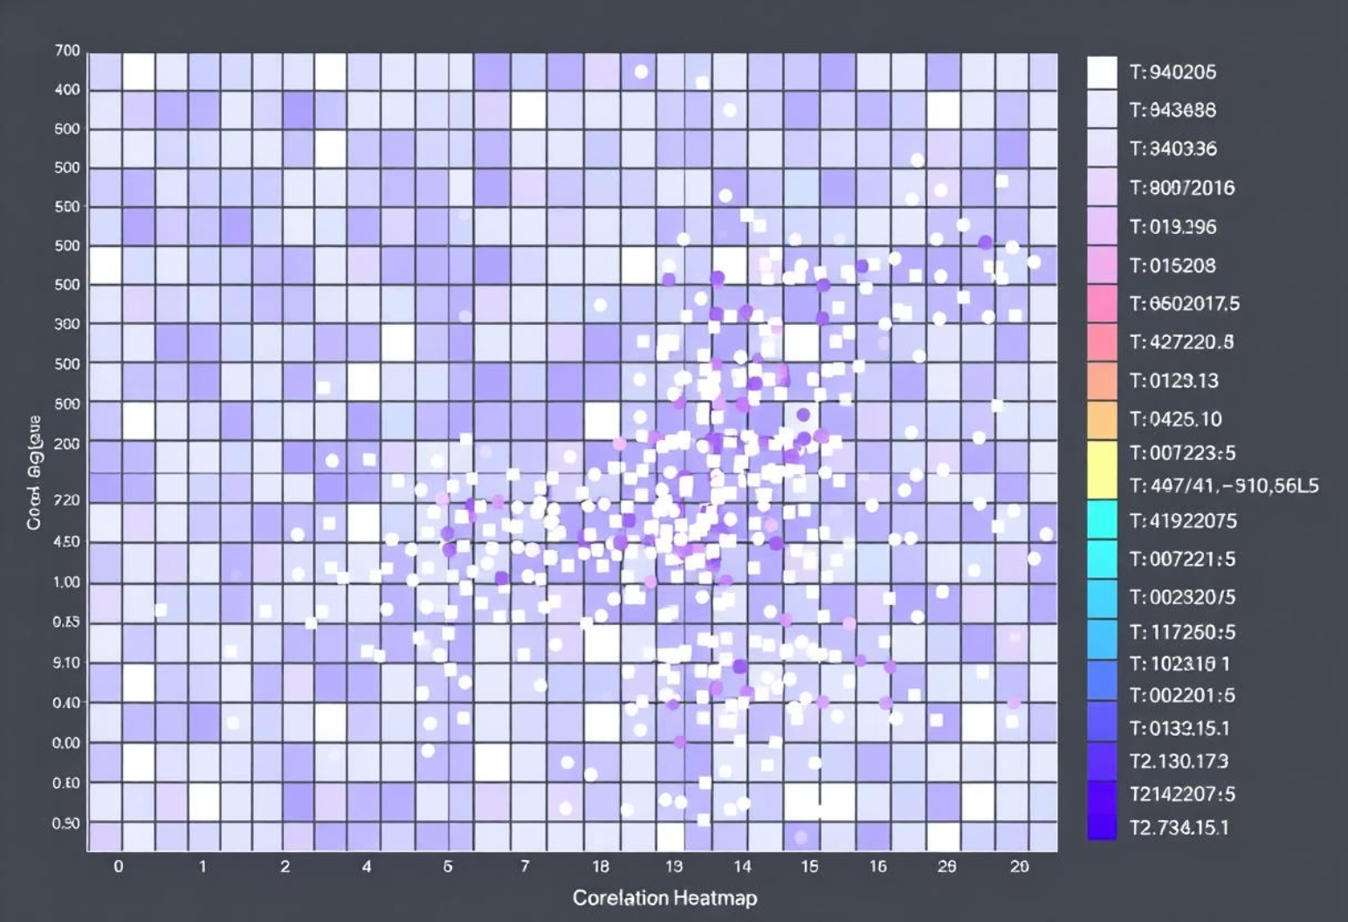



In-depth Data Analysis
Analytical Techniques Applied
Feature Correlation Visualisation
Our analysis phase focused on thoroughly understanding the datasets and identifying key relationships through diverse methods.
Summary Statistics: Descriptive statistics (mean, median, min, max, std dev) and unique value counts were generated to understand data distributions, identify skewness, and detect potential outliers.
Dataset Information: Displayed data types and non-null counts, ensuring column integrity and detecting inconsistent or unexpected entries for robust processing.
Top Categories: Identified most frequent categories in key columns, providing insights into product popularity, customer segments, and regional sales performance.
Correlation heatmap showing relationships between numeric features.
Data Understanding: Summary statistics and dataset info were crucial for understanding data distributions, completeness, and identifying early issues for reliable analysis.
Strategic Focus: Top category analysis revealed dominant groups, enabling strategic focus on key products, customer segments, or high-performing sales regions.
Predictive Insights: The correlation heatmap highlighted relationships between numeric features, aiding in detecting multicollinearity and identifying valuable predictive features.

Slide 14


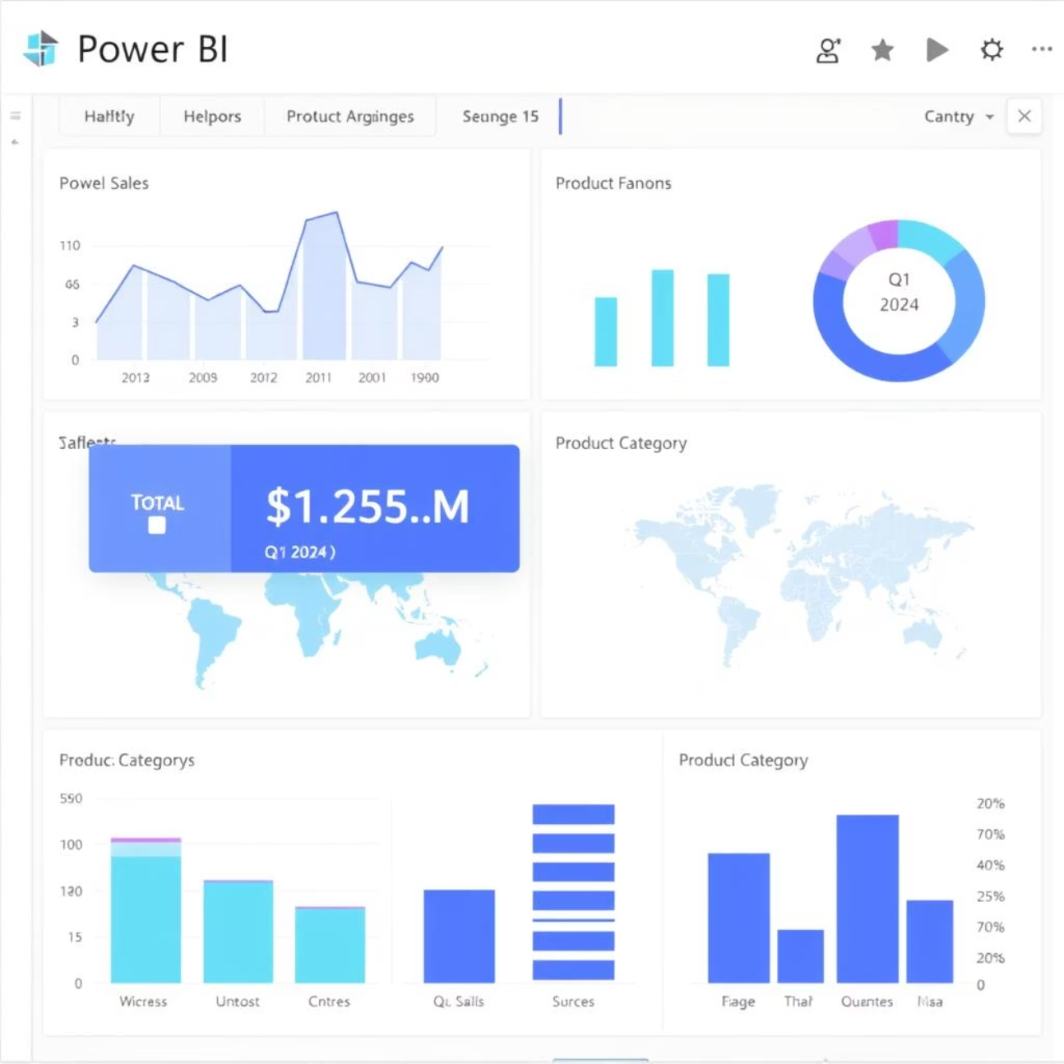

Power BI Work
Interactive Dashboards
Key Metrics Analysis
Dynamic visuals built, data combined for multi-source analysis.
Monitored Sales, AOV, & Customers with DAX measures.
Dynamic Data Filtering
Enabled on-demand exploration via slicers & granular filters.
Why it Matters
User-friendly, real-time insights for all.
Explore trends quickly without code.
Visualises complex data for fast decisions.

Slide 15
Jupyter Notebook Work: In-depth Exploration
Jupyter Notebooks enabled iterative analysis, custom scripting, and comprehensive data understanding for deep insights.
3. Object-Oriented Modelling
2. Data Ingestion & Merge
A custom 'Order' class was defined for structured data handling and programmatic summaries, enhancing reusability.
1. Environment Setup
Raw sales data was loaded from CSVs, then merged and type-casted for unified, accurate temporal analysis.
Core libraries were imported for robust data manipulation, numerical operations, and visualisations.
class Order: def __init__(self, order_id, ...): ...
details_df = pd.read_csv("Details.csv")merged_df = pd.merge(orders_df, details_df)
import pandas as pdimport seaborn as sns

Slide 16


Slide 17
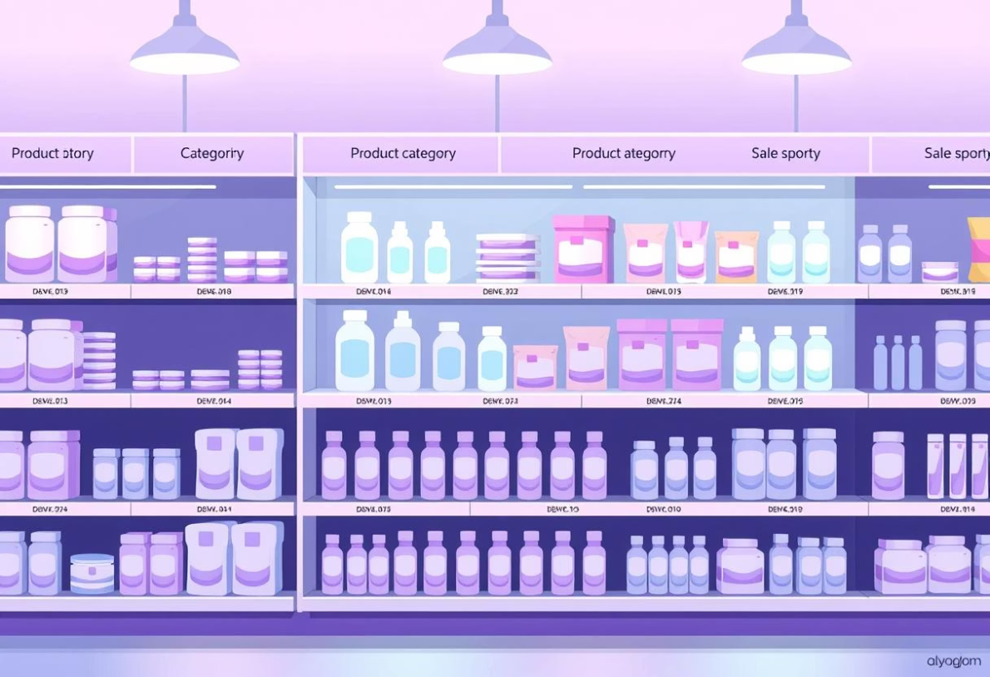




Jupyter Notebook: Advanced Analysis
Building upon foundational data handling, our Jupyter Notebook exploration deepened into object-oriented design and comprehensive analytical functions, culminating in visual insights and prepared data for Power BI.
Enhanced Data Modelling
Targeted Data Analytics
Exploratory Visualisation
We extended our data model by defining a Customer class that inherits from the Order class. This approach facilitates structured data handling, enabling a more intuitive representation of customer-specific attributes and behaviours.
Custom functions were developed to perform key calculations, providing rapid insights into various performance metrics.
Visual exploratory analysis was conducted to highlight key sales drivers. A bar chart effectively illustrated sales distribution across different product categories.
Total Sales: Aggregating overall revenue for a complete financial overview.
Instantiation of customer objects allows for programmatic access to individual order details and aggregated summaries, enhancing code reusability and maintainability for complex analysis.
Average Profit: Determining profitability per transaction to assess financial health.
Monthly Sales Trends: Tracking sales performance over time to identify seasonal patterns and growth.
Orders per City: Analysing geographical sales distribution to pinpoint high-performing regions.
This visualisation quickly identified top-performing categories, guiding strategic inventory management and marketing efforts.
The comprehensive analysis in Jupyter culminated in exporting the final, cleaned dataset as Ecommerce_Final_Cleaned.csv. This prepared dataset is now ready for advanced dashboarding and reporting in Power BI, ensuring seamless integration and consistency.
Summary of Achievements
OOP Structure
Custom Functions
Order & Customer classes with inheritance for reusable data handling.
User-defined functions for total sales, profit, and trends.
EDA Visualisations
Data Export
Bar charts and other plots revealed key sales insights.
Cleaned dataset prepared for Power BI integration.

Slide 18
Power BI Report: RN E-Commerce Dashboard
This Power BI dashboard offers comprehensive performance analysis for an e-commerce platform, providing crucial insights into sales, profits, customer behaviour, and product categories.
Key Metrics Tracked
Visualisations Used
Total Sales & Profit
Bar/Column Charts
Total Orders
Pie/Donut Charts
Average Profit Margin
Line Graphs
Top-Selling Products
KPI Cards
Critical insights highlight technology's strong performance and call for optimising shipping and discount strategies to enhance overall profitability across all regions and segments.

